Slide 1
MVVM Architecture
Dineshkumar S | Gokul P | Vishal A

Slide 2
What is MVVM ?
Splits the user interface in Model, View, View Model
Model – data from database
View – visual representation of the data, the part that user interacts with
View Model – the glue between the view and the model. Controls the view interaction with the application and wraps the data from model for the view

Slide 3
The Model
The model represents the actual data and/or information we are dealing with. An example of a model might be a contact (containing name, phone number, address, etc)
The key to remember with the model is that it holds the information, but not behaviors or services that manipulate the information. For example, It is not responsible for formatting text to look pretty on the screen, or fetching a list of items from a remote server

Slide 4
The View
It is the presentation of the data. The view takes certain liberties to make this data more presentable.
A view can also have behaviors associated with it, such as accepting user input. The view manages input (key presses, mouse movements, touch gestures, etc) which ultimately manipulates properties of the model. For example, a date might be stored on the model as number of seconds since midnight on January 1, 2020, to the end user, however, it is presented with the month name, date, and year in their local time zone based on user input.

Slide 5
The ViewModel
Instead of making the model aware of the user’s view of a date, so that it converts the date to the display format, the model simply holds the data, the view simply holds the formatted date.
The controller might take input from the view and place it on the model, or it might interact with a service to retrieve the model, then translate properties and place it on the view.

Slide 6
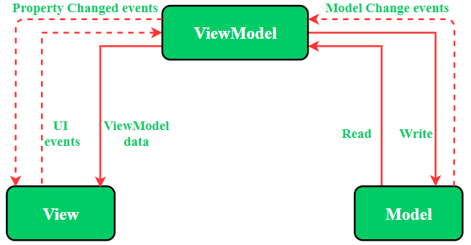

Slide 7
The View and the ViewModel
The view and the viewmodel communicate via data-binding, method calls, properties, events, and messages
The view handles its own UI events, then maps them to the viewmodel via commands
The models and properties on the viewmodel are updated from the view via two-way databinding

Slide 8
The ViewModel and the Model
The viewmodel may expose the model directly, or properties related to the model, for data-binding
The viewmodel can contain interfaces to services, configuration data, etc in order to fetch and manipulate the properties it exposes to the view

Slide 9
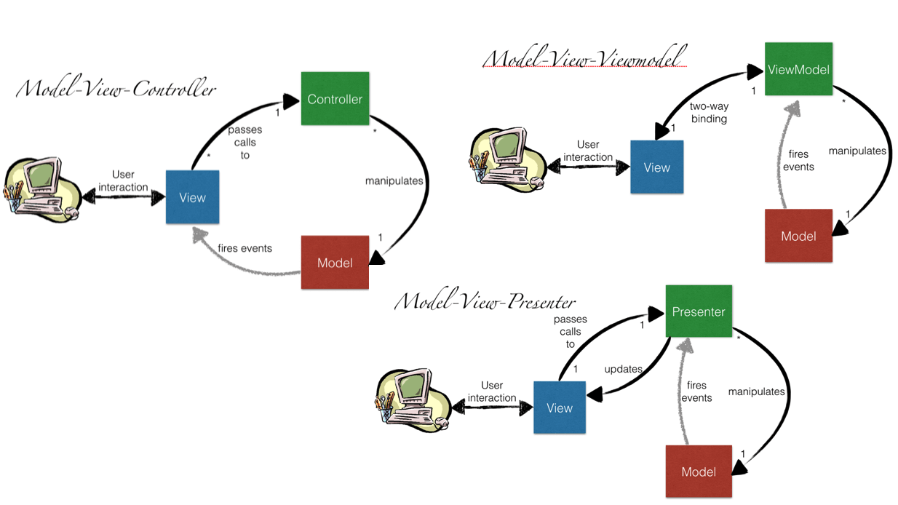

Slide 10
Ways to implement MVVM
There are 2 ways to implement MVVM design pattern in Android projects:
Using the DataBinding library released by Google
Using any tool like RxJava for DataBinding.

Slide 11
Advantages of MVVM
Separation of UI Design and Development
Different view can be used with same view model
Easier for unit testing
Easy to redesign the UI

Slide 12
Disadvantages of MVVM
This design pattern is not ideal for small projects.
If the data binding logic is too complex, the application debug will be a little harder

